Slide 1
Fairness In Machine Learning With Tabular Structured Data
Student: Karim Kallich,
Mohamed Eltayeb
Mentor: Narayanan Venkit, Pranav
Professor: Dr. Ahmed Rashed
Wrap Presentation

Slide 2
Introduction
Fairness in machine learning with tabular structured datasets.
Libraries: Fairlearn, AI Fairness 360 (AIF360), and What-If Tool.

Slide 3
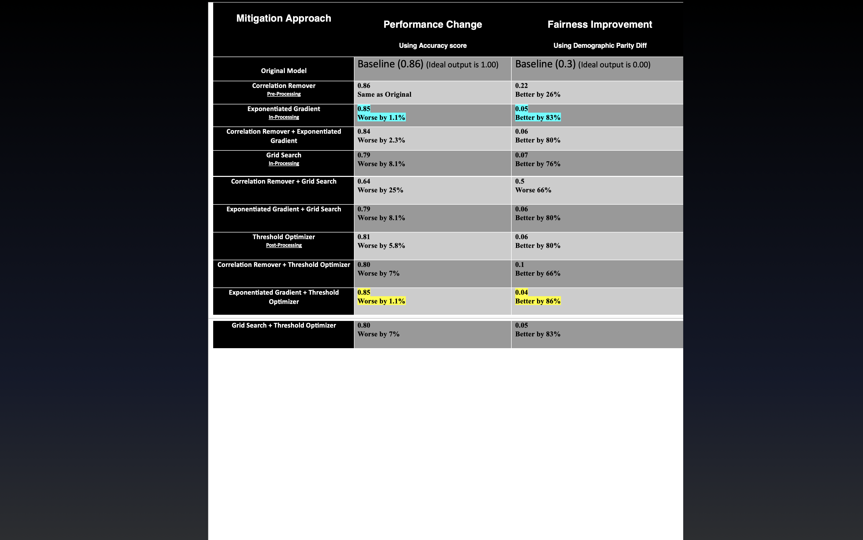
Fairlearn Results

Slide 4
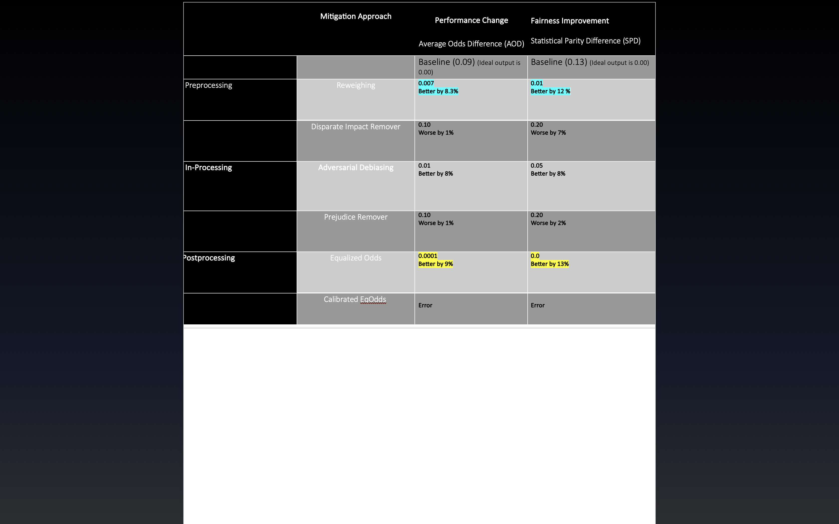
AIF360 Results

Slide 5
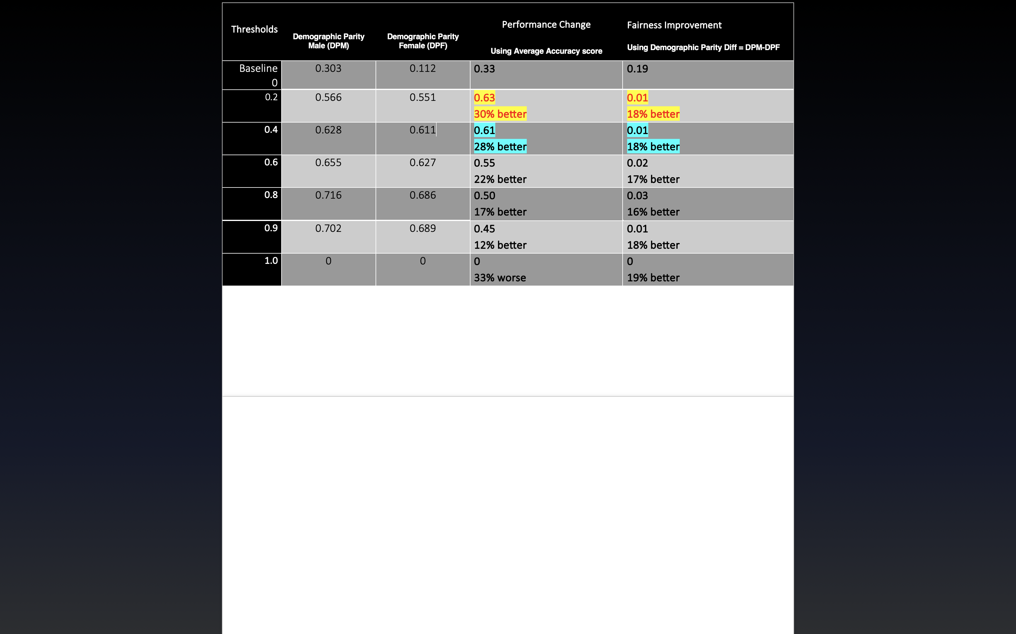
What-If-Tool Results

